Slide 1
Four Player Based Quiz System
Course No: EEE 304
Course Title: Digital Electronics Laboratory
Group No: 01 Members: 1706001
1706004
1706007
1706032
Submitted To:
Mr. Hamidur Rahman
Rifat Shahriar

Slide 2
In our project,there are four participants
Inputs are taken from Logic Toggle (Buzzers)
Maximum achievable point is 9
Point reduction for wrong answer is available but points cannot be reduced to negative
Winner/s is/are shown by LED
Features:s

Slide 3
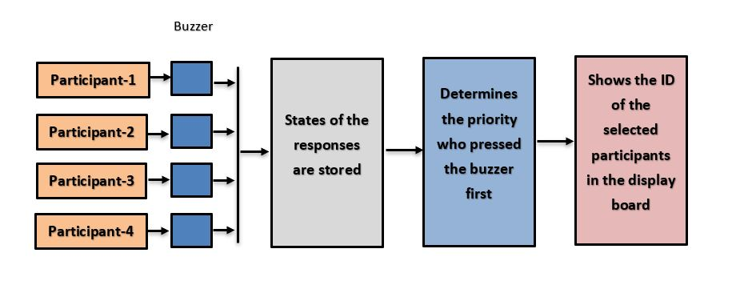
Workflow:

Slide 4
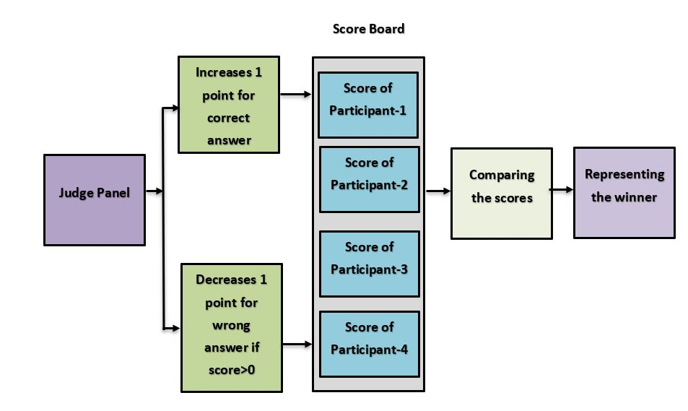

Slide 5
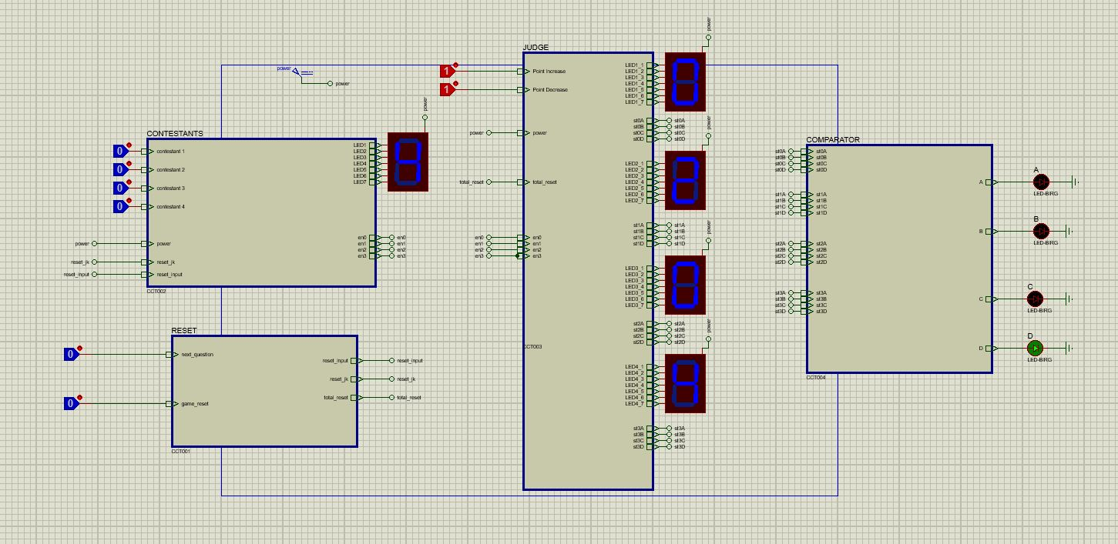
Circuit Diagram:

Slide 6
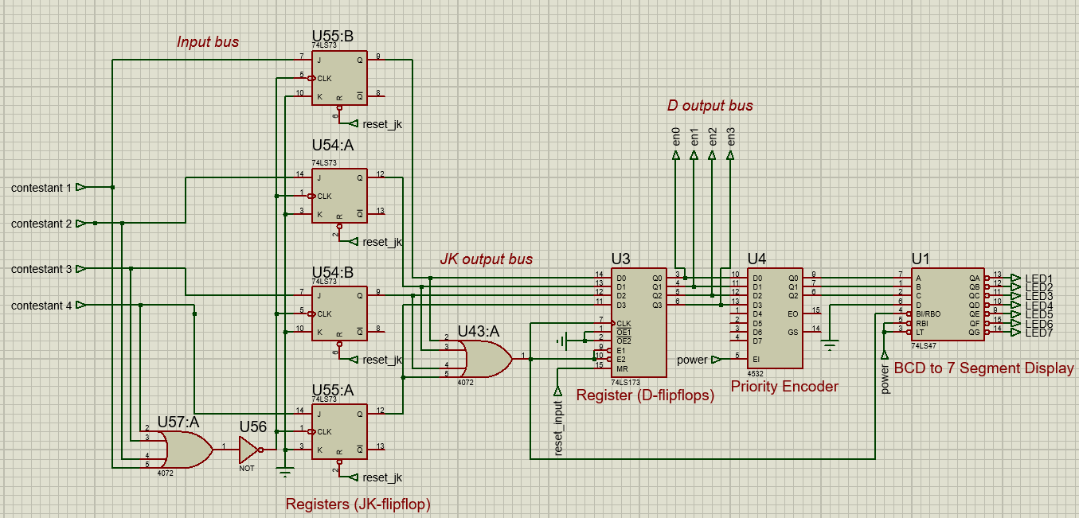
Subcircuit of Contestant stage
Input Bus
Takes toggle information of the contestants
JK output bus
Stores the info whenever buzzers are pressed
D output bus
Only registers the participants who press 1st

Slide 7
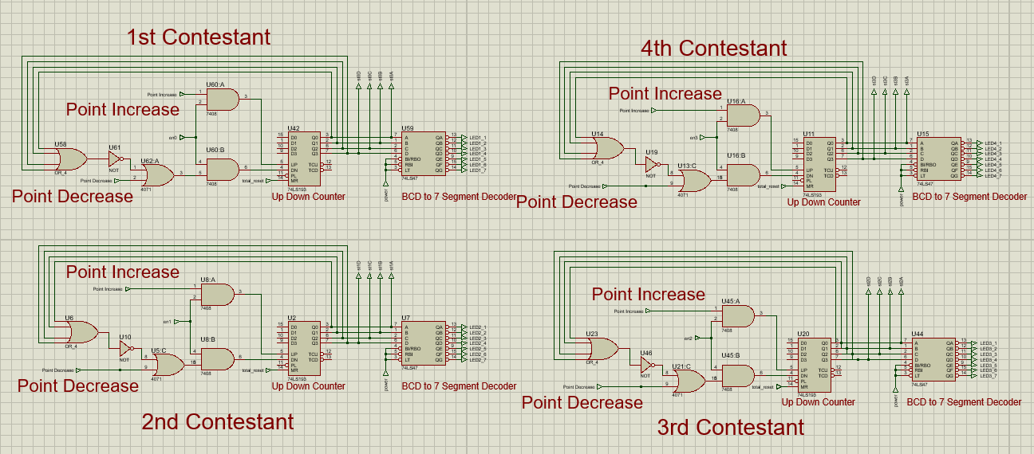
Subcircuit of Judge stage

Slide 8
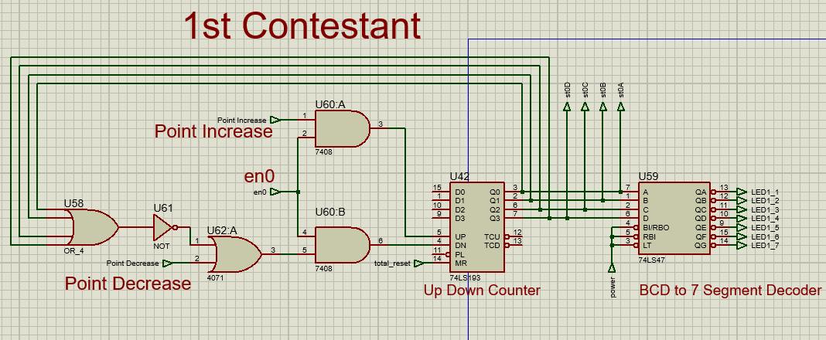
Subcircuit of Judge stage
If ‘Point increase’ is toggled,
If ‘en0’ = 1, then current score will increase by 1.
else, counter will not current change state
UP = ‘en0’ & ‘Point increase’
If ‘Point decrease’ is toggled,
If ‘en0’ = 1 and current score != 0, then current score will decrease by 1.
else, counter will not current change state
DN = ‘en0’ & (‘Point decrease’ | !’Current score’)

Slide 9
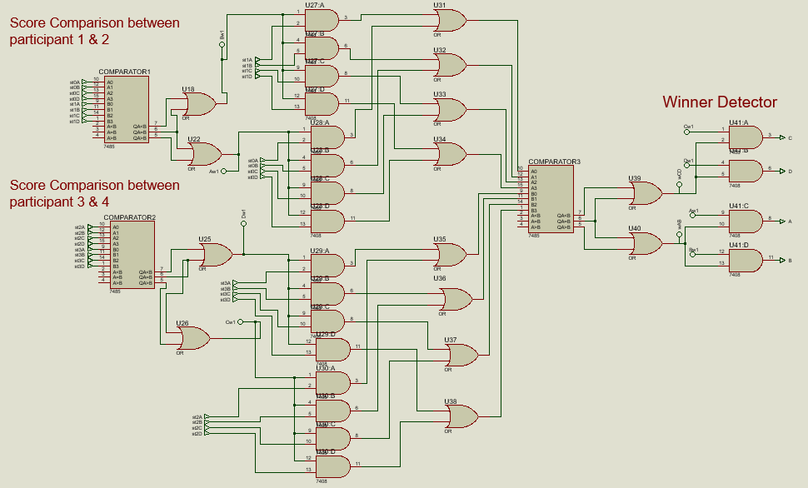
Subcircuit of Comparator stage
Comparator Circuit

Slide 10
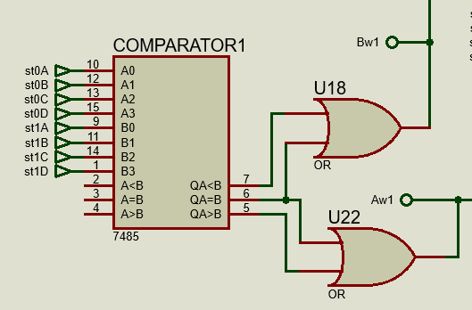
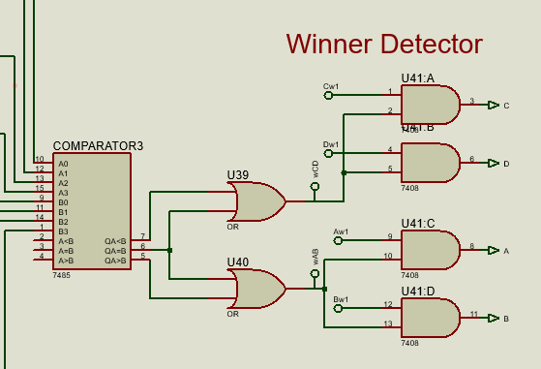
Logic Analysis
Comparator 1 compares between score of participant 1 & participant 2
Aw1=QA>B or QA=B
Likewise, Bw1=QA<B or QA=B
Comparator 2 compares between score of participant 3 & participant 4.
Parameters- Cw1, Dw1
Comparator 3 compares between the highest scorer from comparator 1 & comparator 2
Value of A,B,C,D is either 0 or 1 which decides the winner of the game

Slide 11
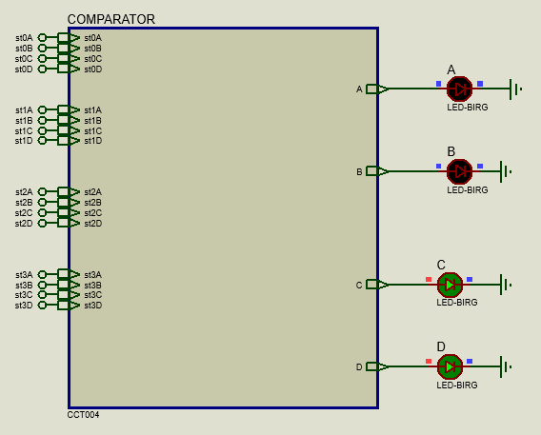
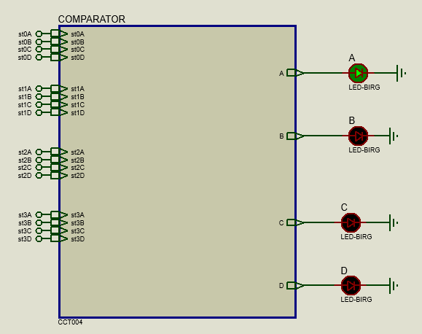
Logic Analysis
Comparator output A, B, C & D determines the winner
If 2 output led is ON, then the match is tie between the corresponding participants
Case 2: LED C & D are ON, match is tie between participant 3 & 4
Case 1: LED A is ON, winner is participant 1

Slide 12
Cost Estimation
Parts Name | Total Units | Corresponding IC units | Price(Tk)
OR Gate | 36 | IC 7432 (4 gate per IC) | 25X9= 225
AND | 28 | IC 7408 (4 gate per IC) | 20X7=140
NOT | 6 | IC 7404(6 gate per IC) | 25X1= 25
BCD to 7 segment decoder | 5 | IC 74LS47 | 50X5= 250
JK Flip-Flop | 4 | IC 74LS73 (2 per IC) | 68X2= 136
Up-Down Binary Counter | 4 | IC 74LS193 | 60X4 = 240
4-bit D type register | 1 | IC 74LS173 | 48X1= 48
8 bit priority encoder | 1 | IC 4532 | 48X1= 48
7 segment LED display common cathode | 5 | - | 10X5= 50
(total) 1162 Tk.

Slide 13
Future Prospects
Increasing question numbers with double digit seven segment display
Generalizing number of players instead of only 4 players
Improving comparator design for winner determination
Accepting answer only within preset time limit
Designing quiz system with elimination per round

Slide 14
Thank You
Have a nice day!

Slide 15


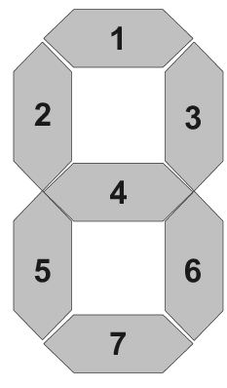
Winning state of each player
Current score of each player
Player Buzzers
A
Judge stage
(To store and update player score)
Contestant stage
(To find the first player)
A
A
B
Comparator stage
(To declare winner)
C
B
B
D
C
C
Reset
D
D
Point
Increase
Point
Decrease
Reset Game
Take Next Question

